Slide 1
Lecture 3: Continuous and Discrete-Time Systems

Slide 2
Representing Systems

Slide 3
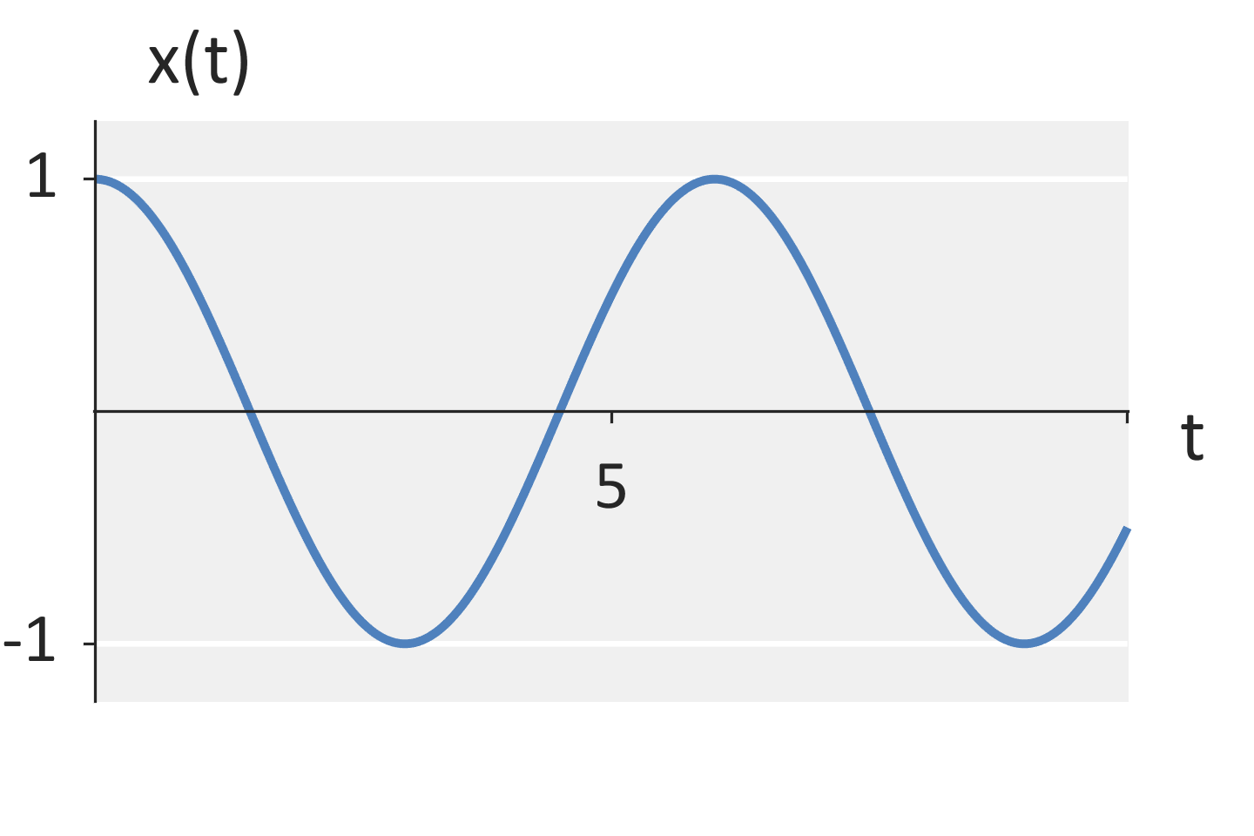
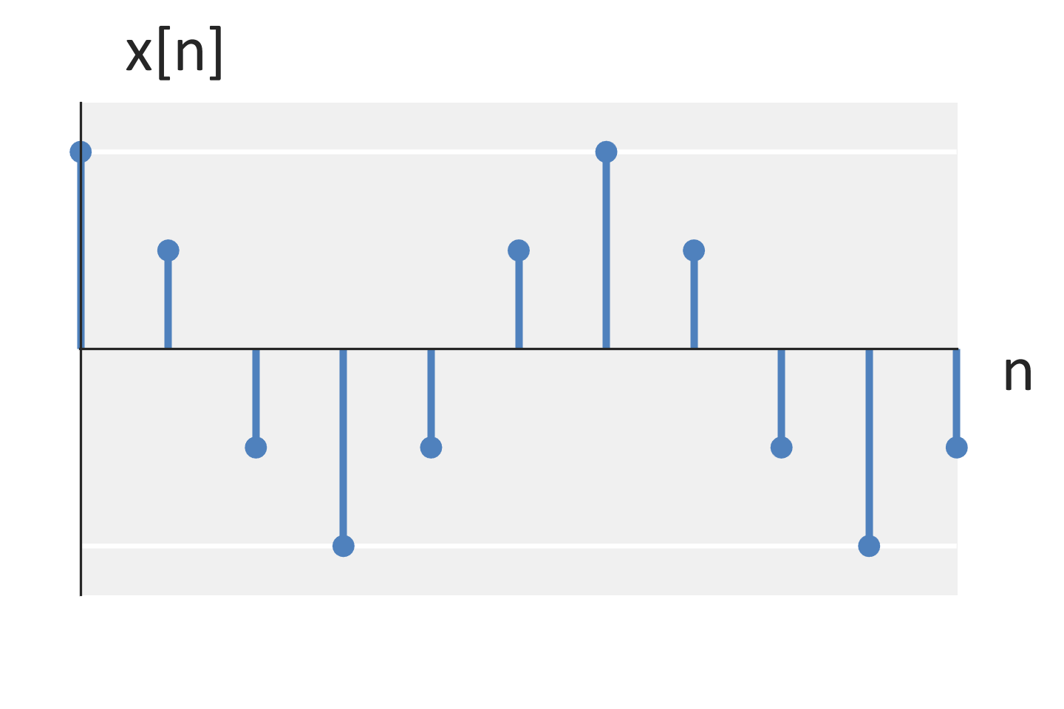
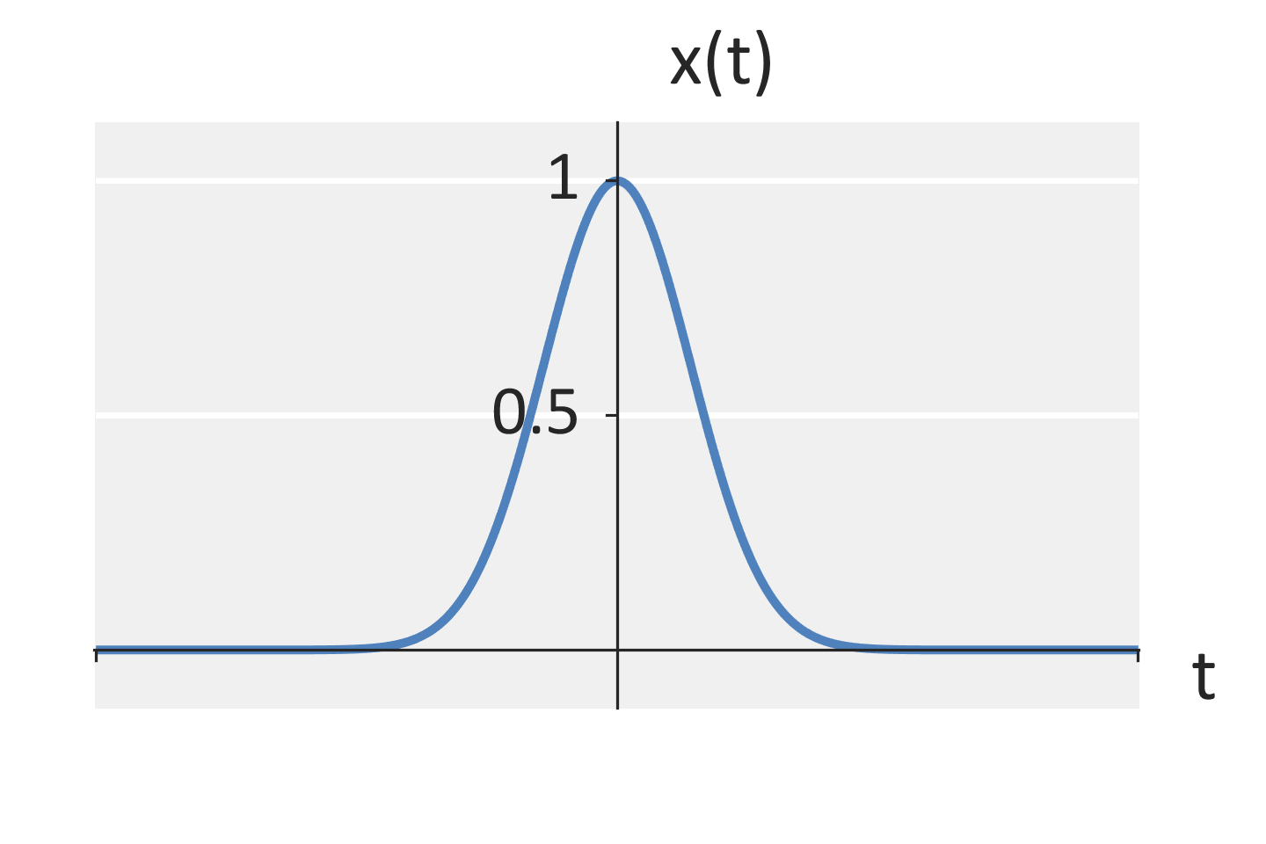
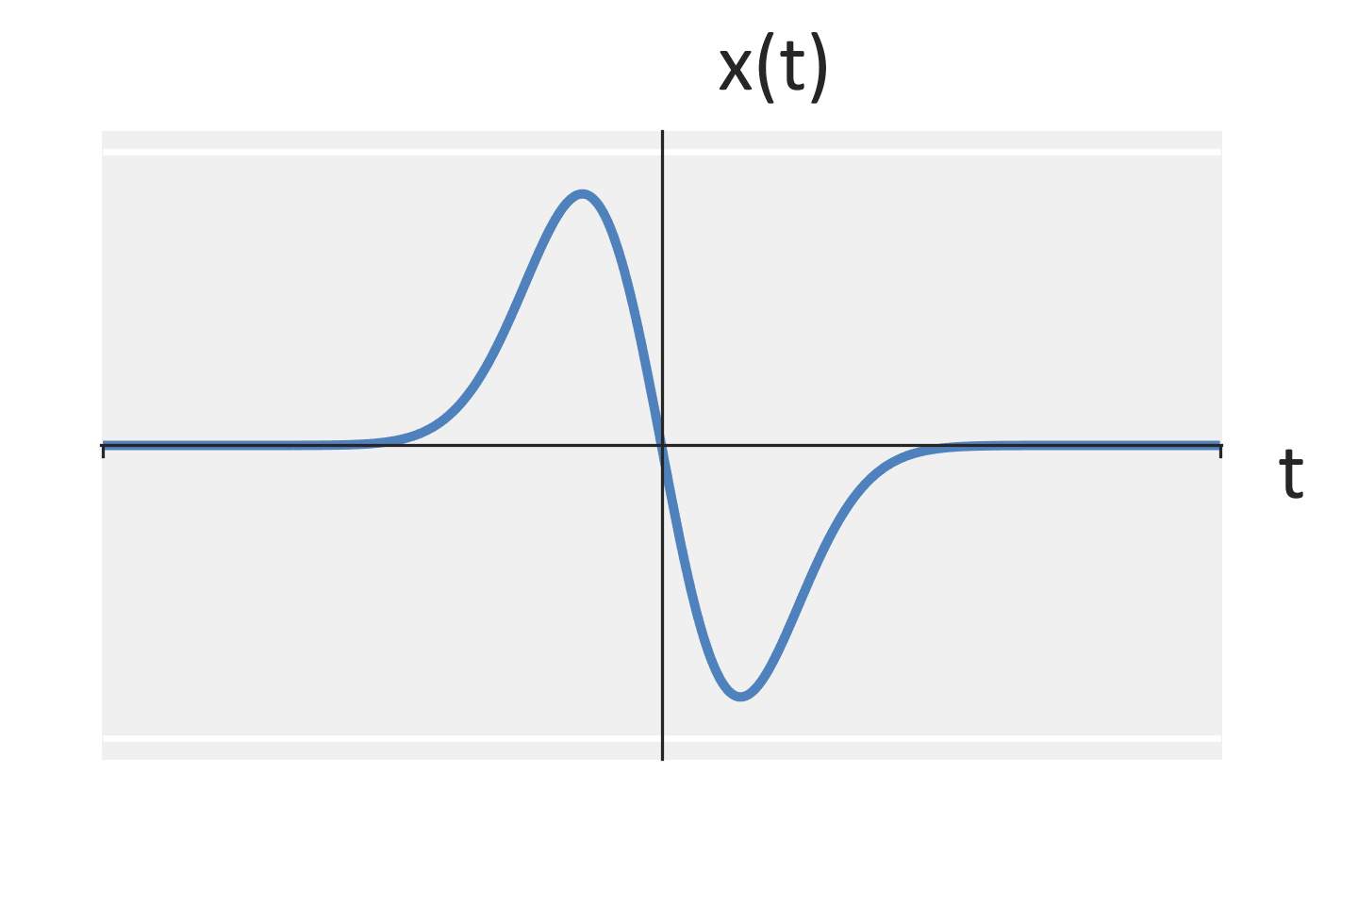
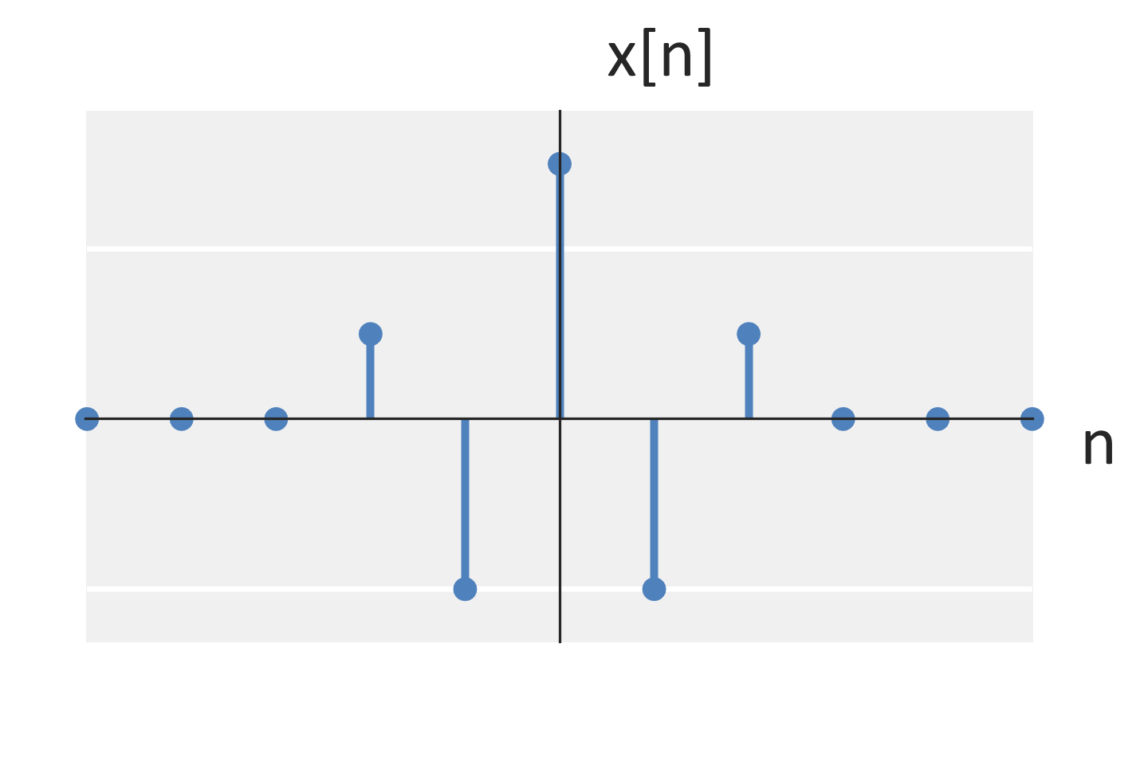
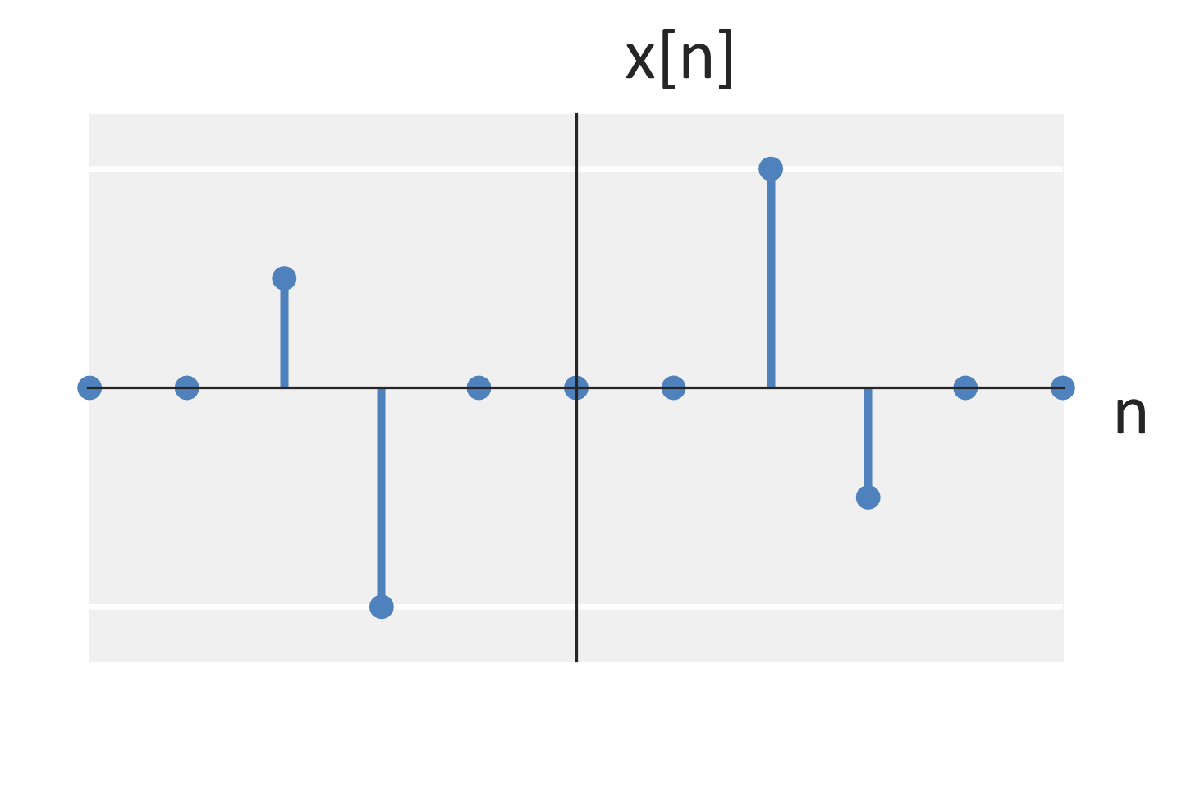
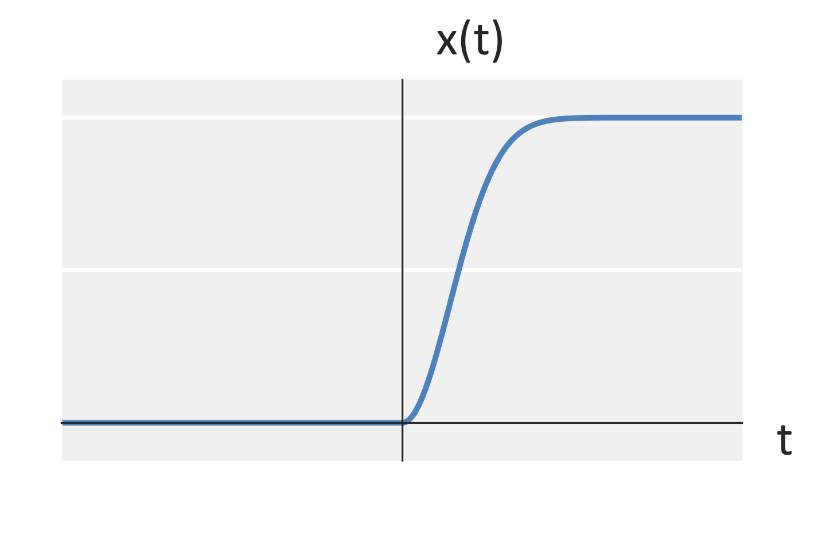
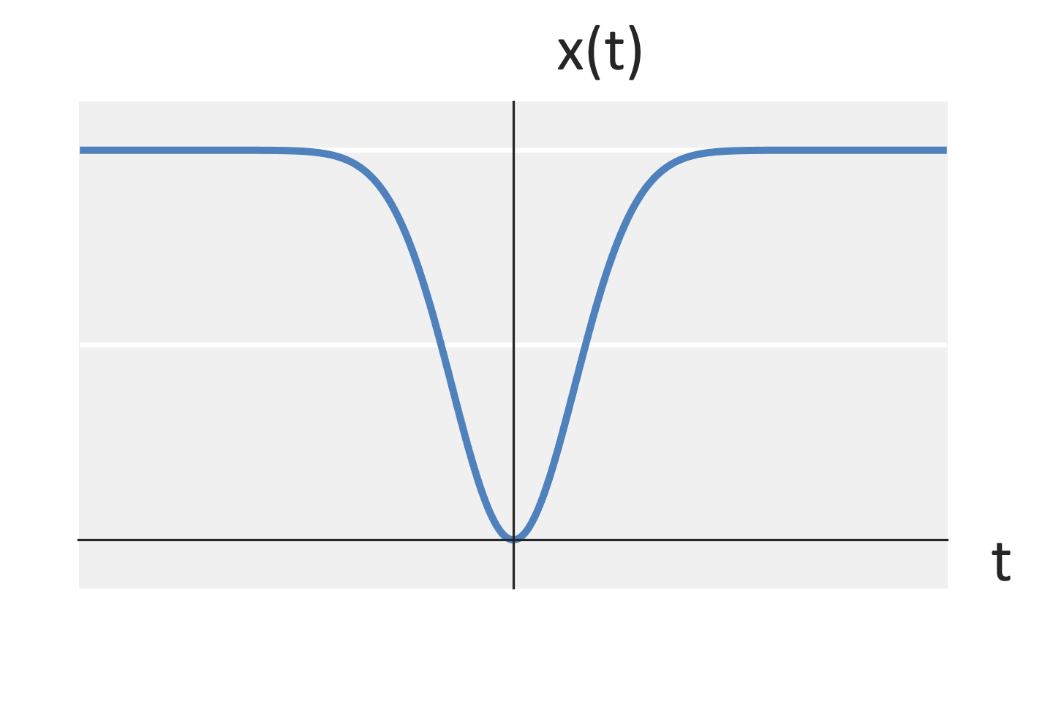
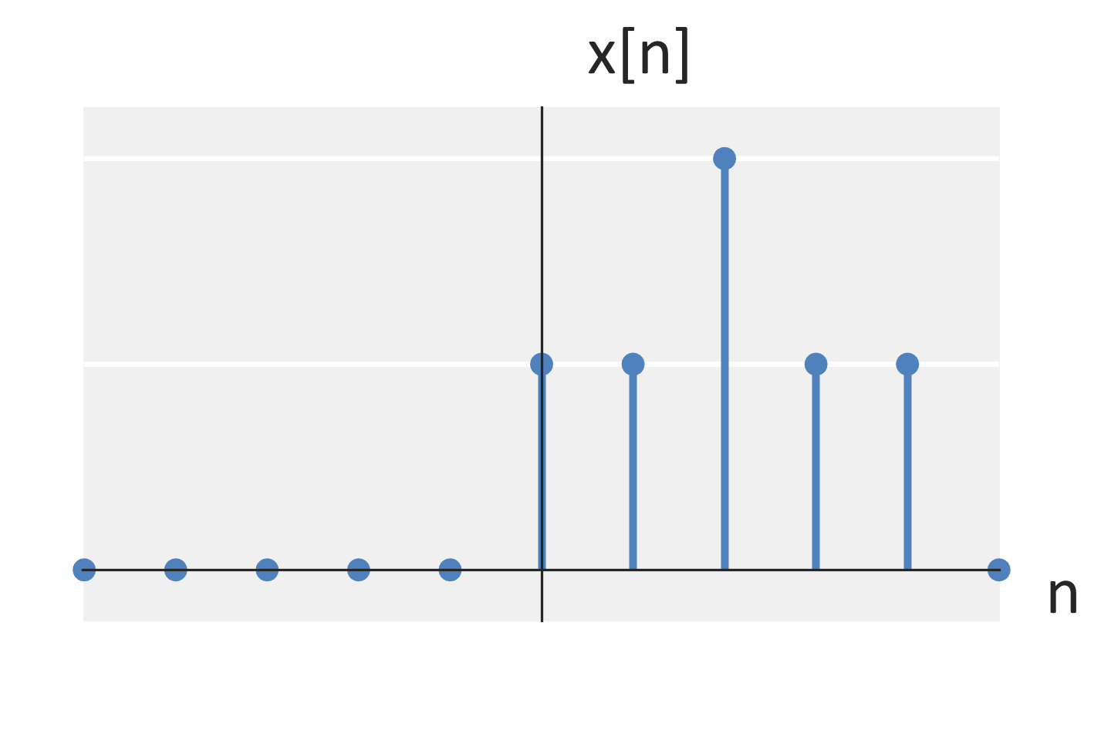
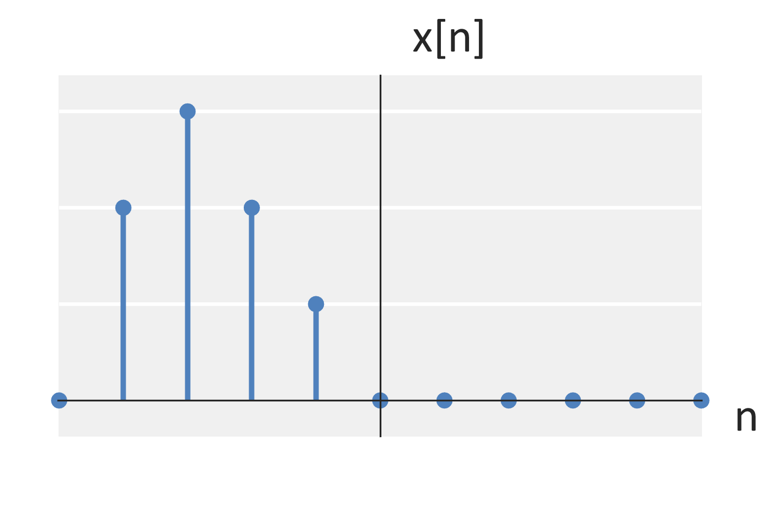
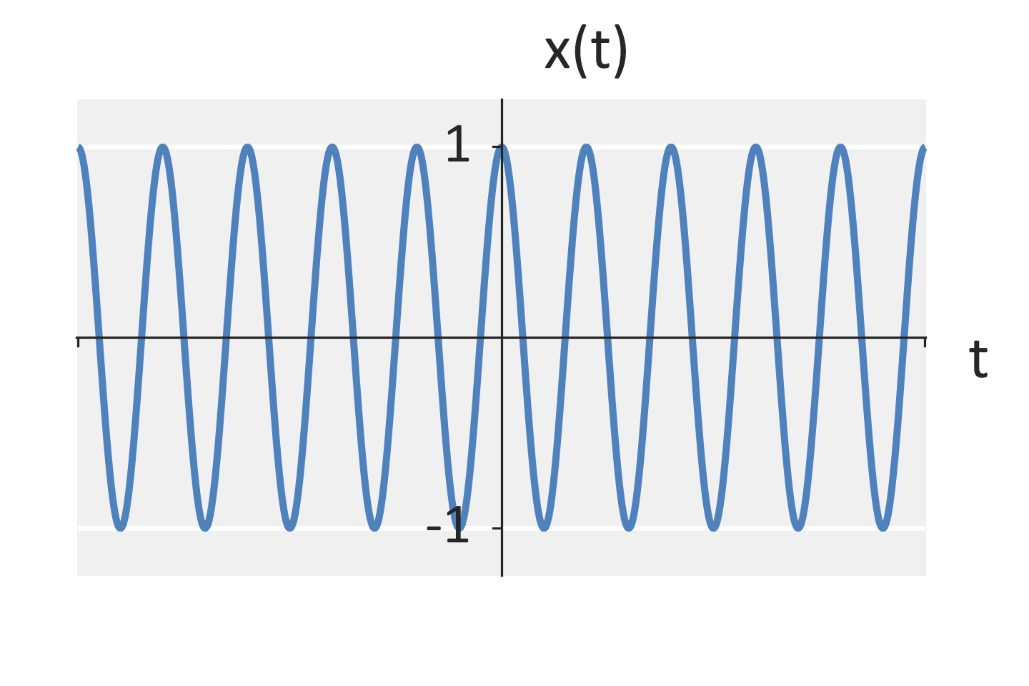
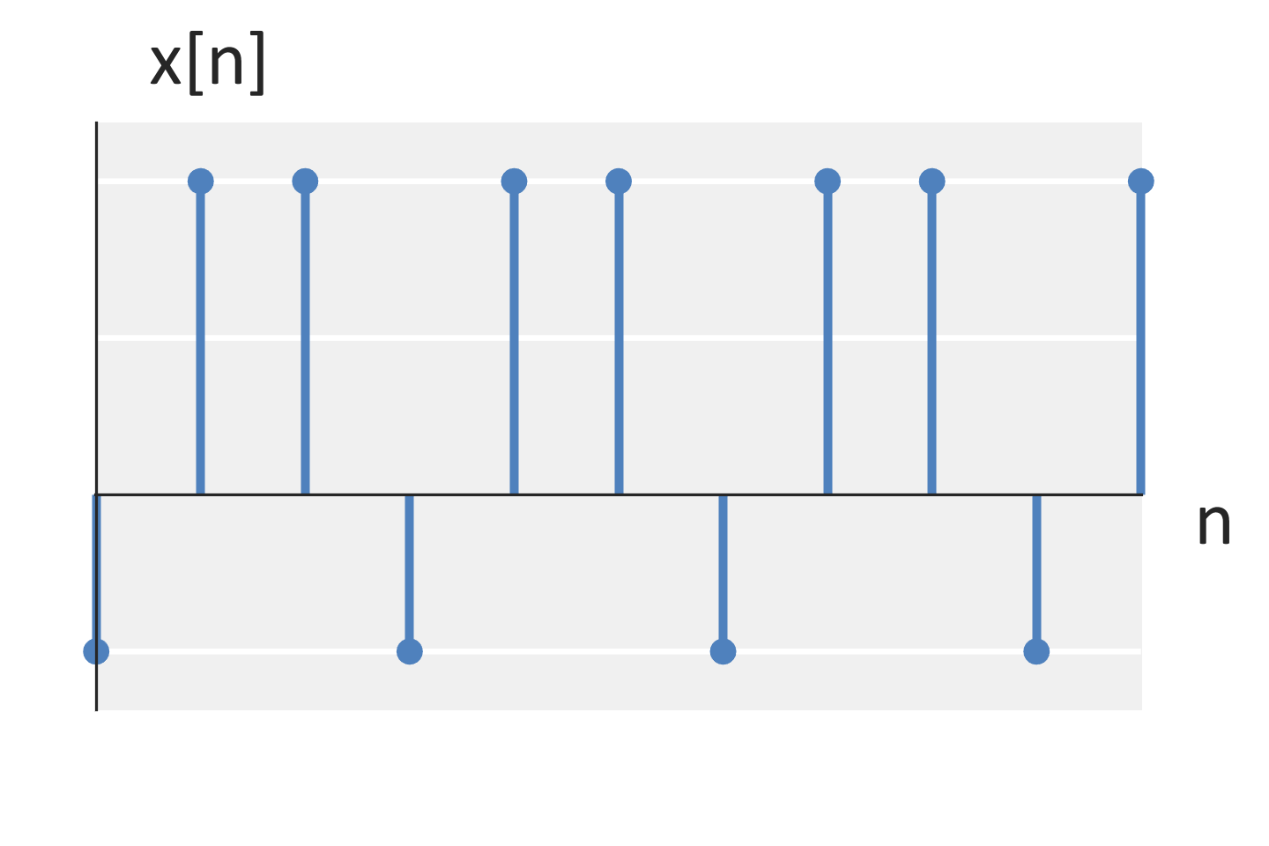
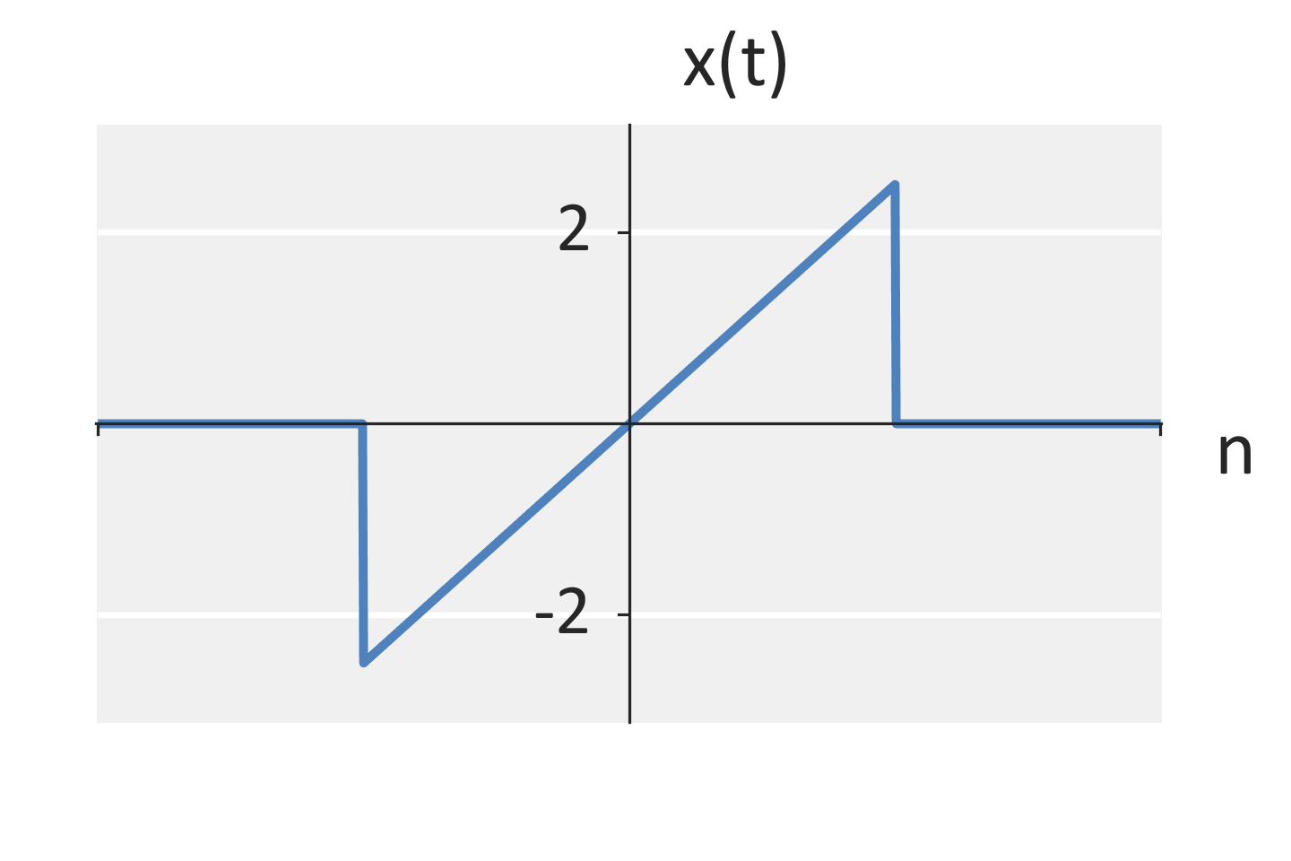
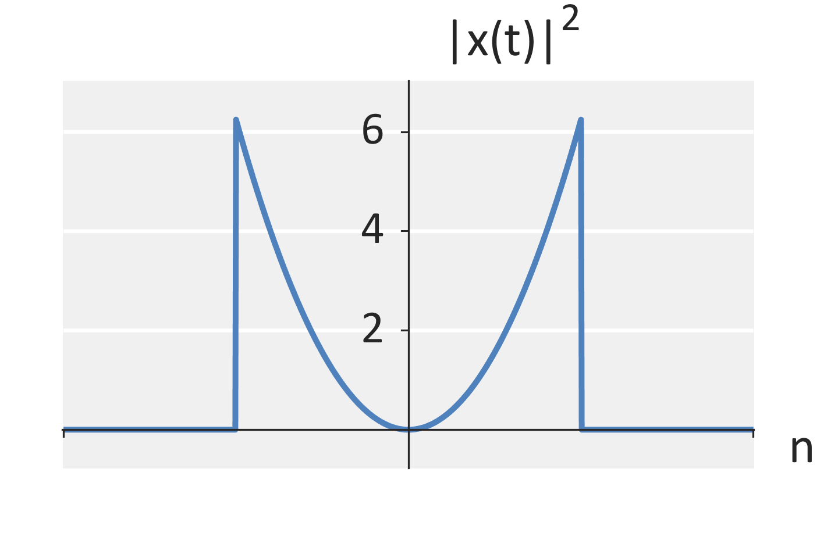
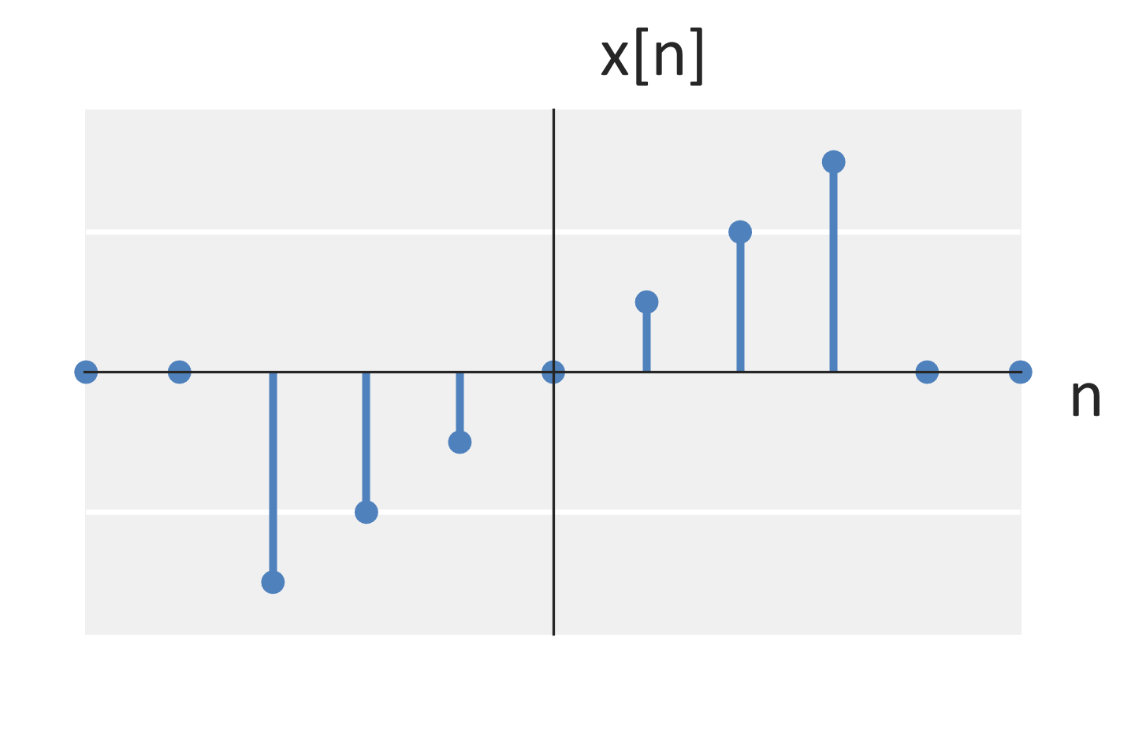
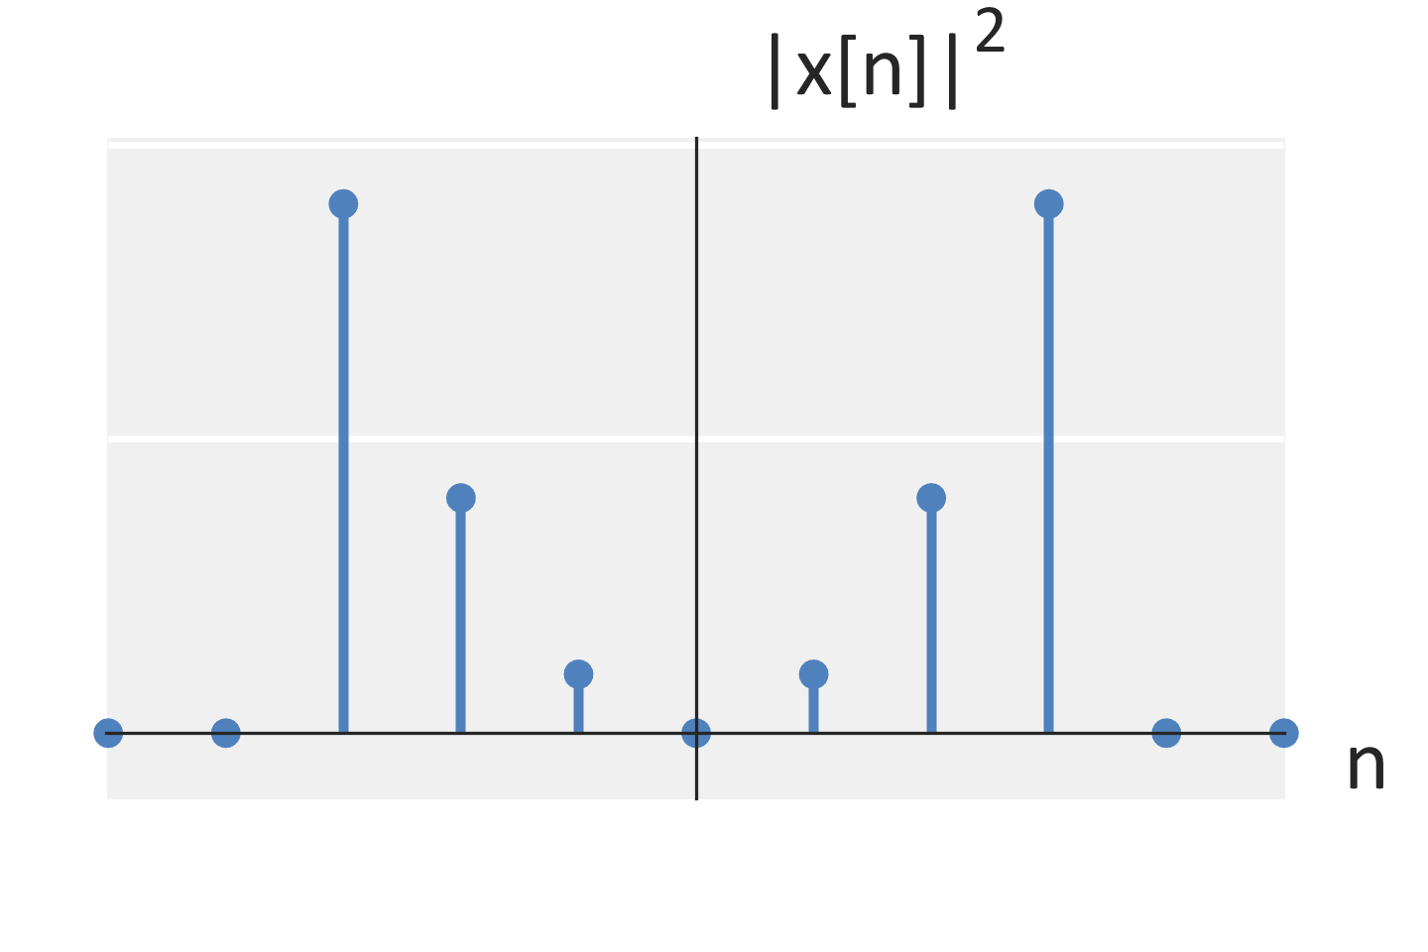
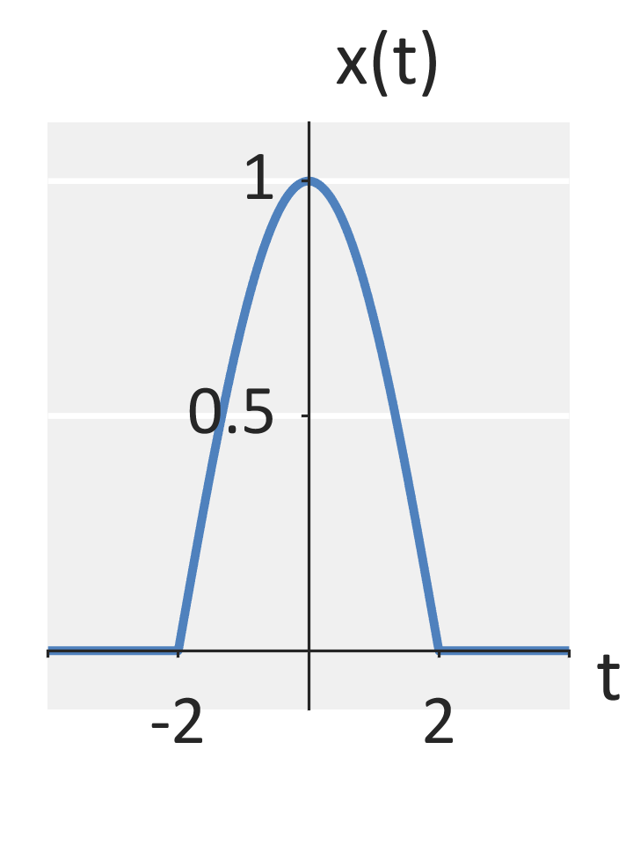
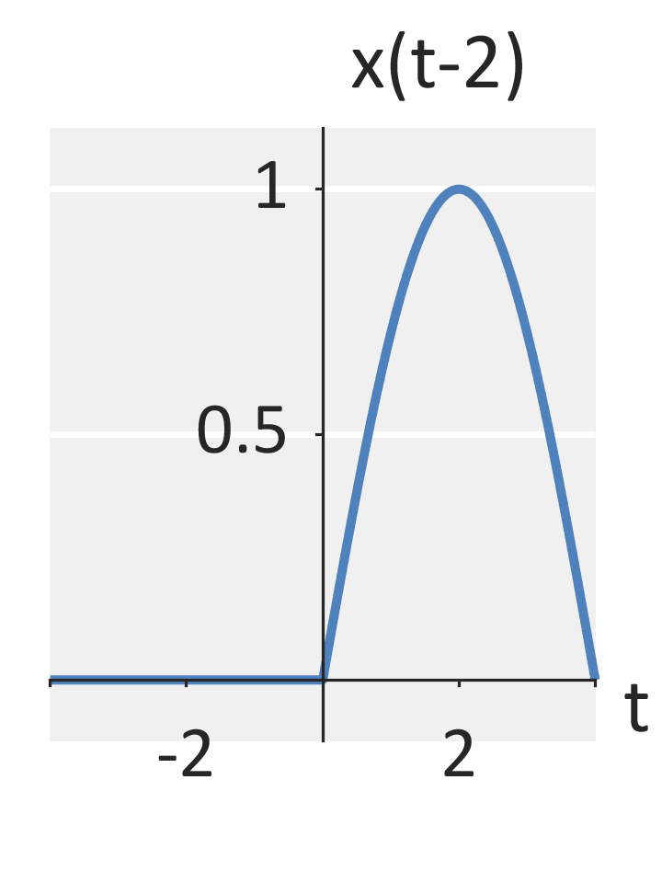
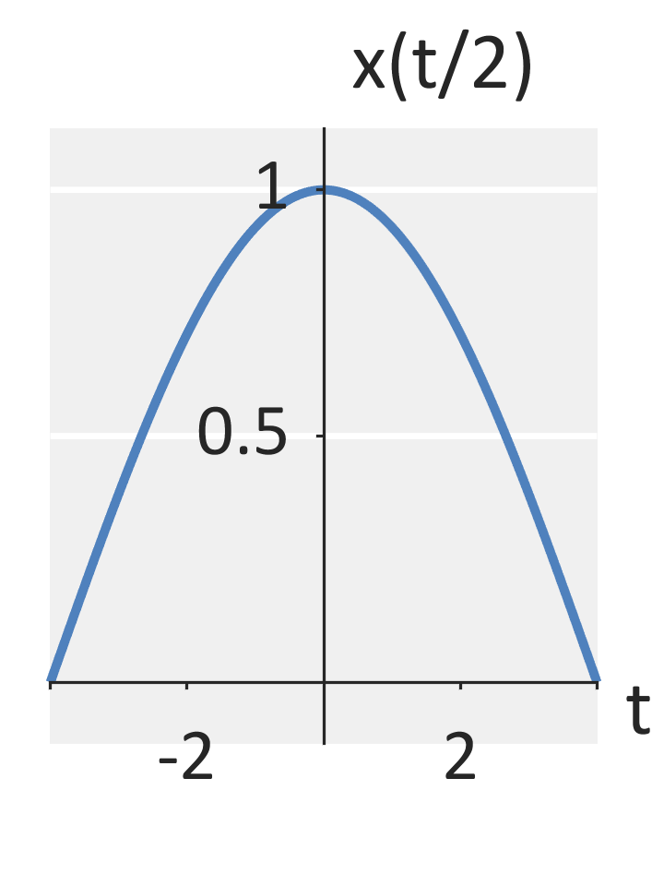
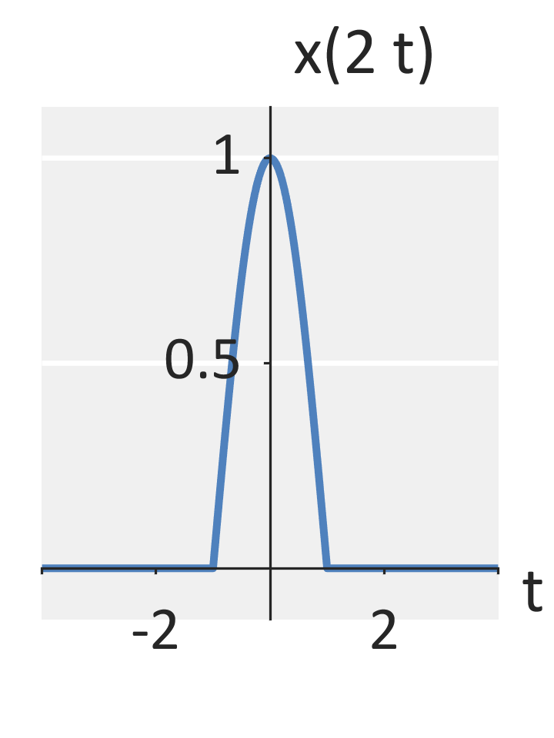
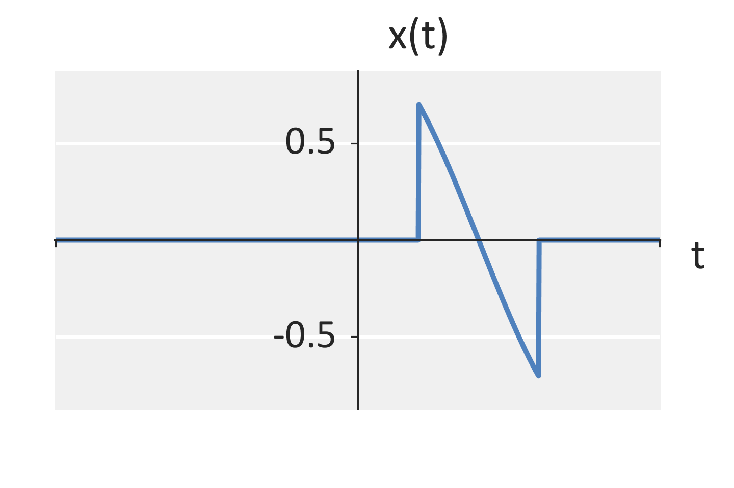
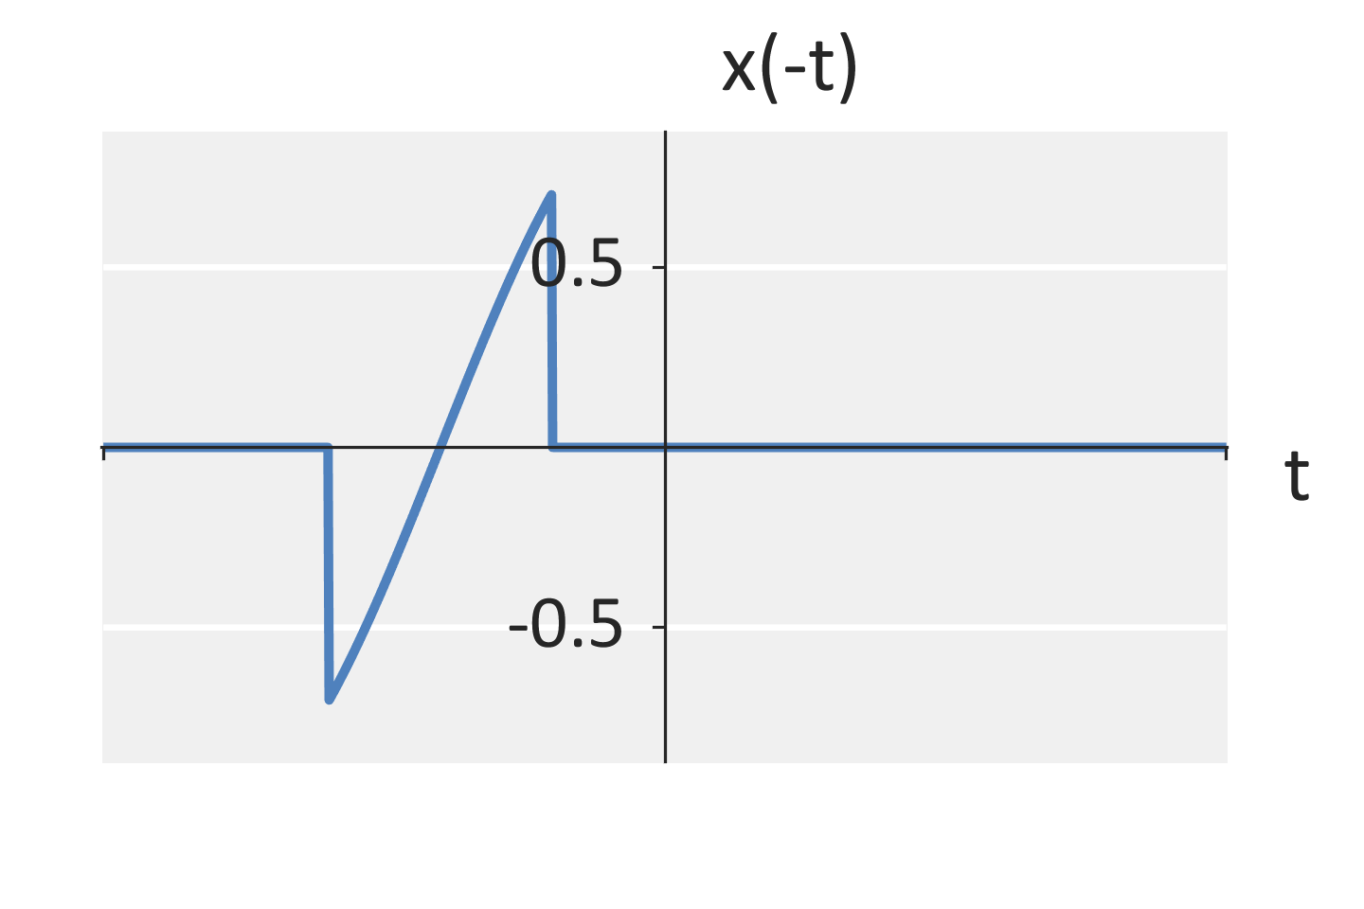
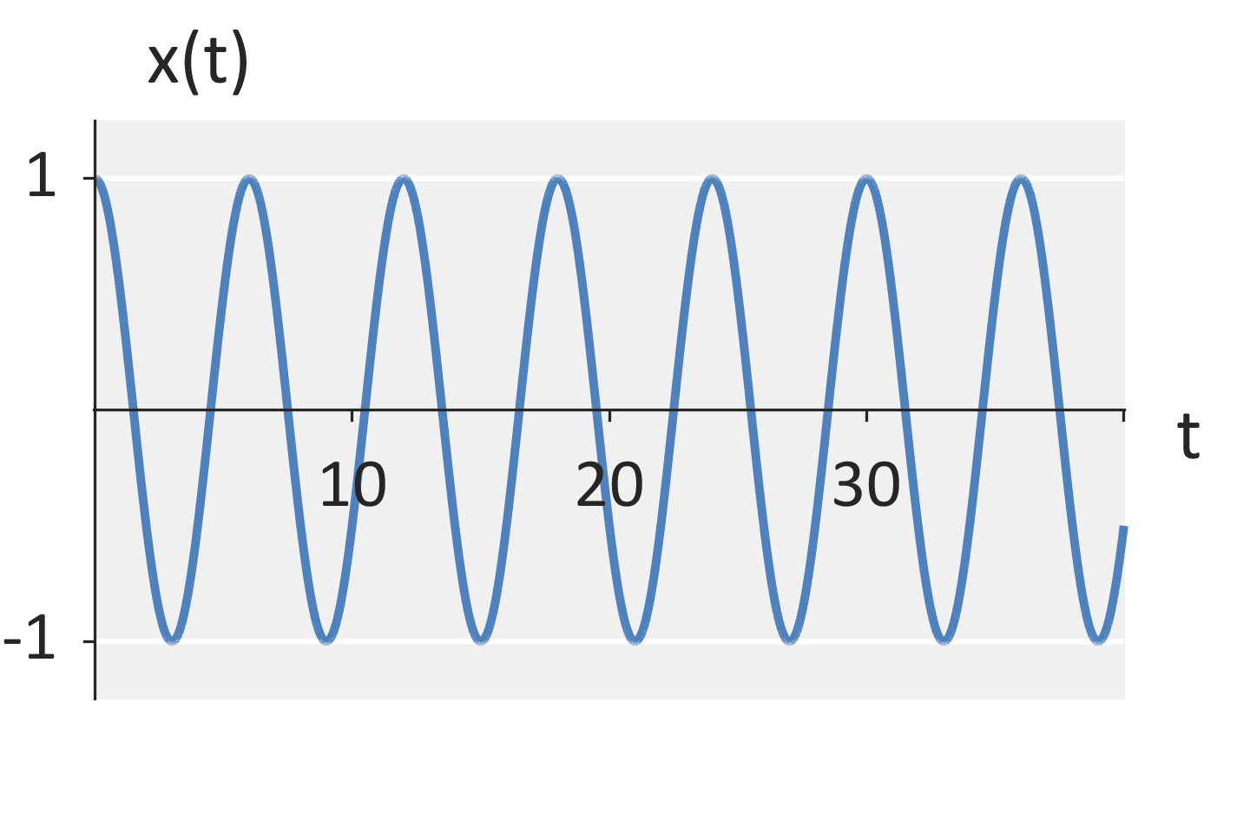
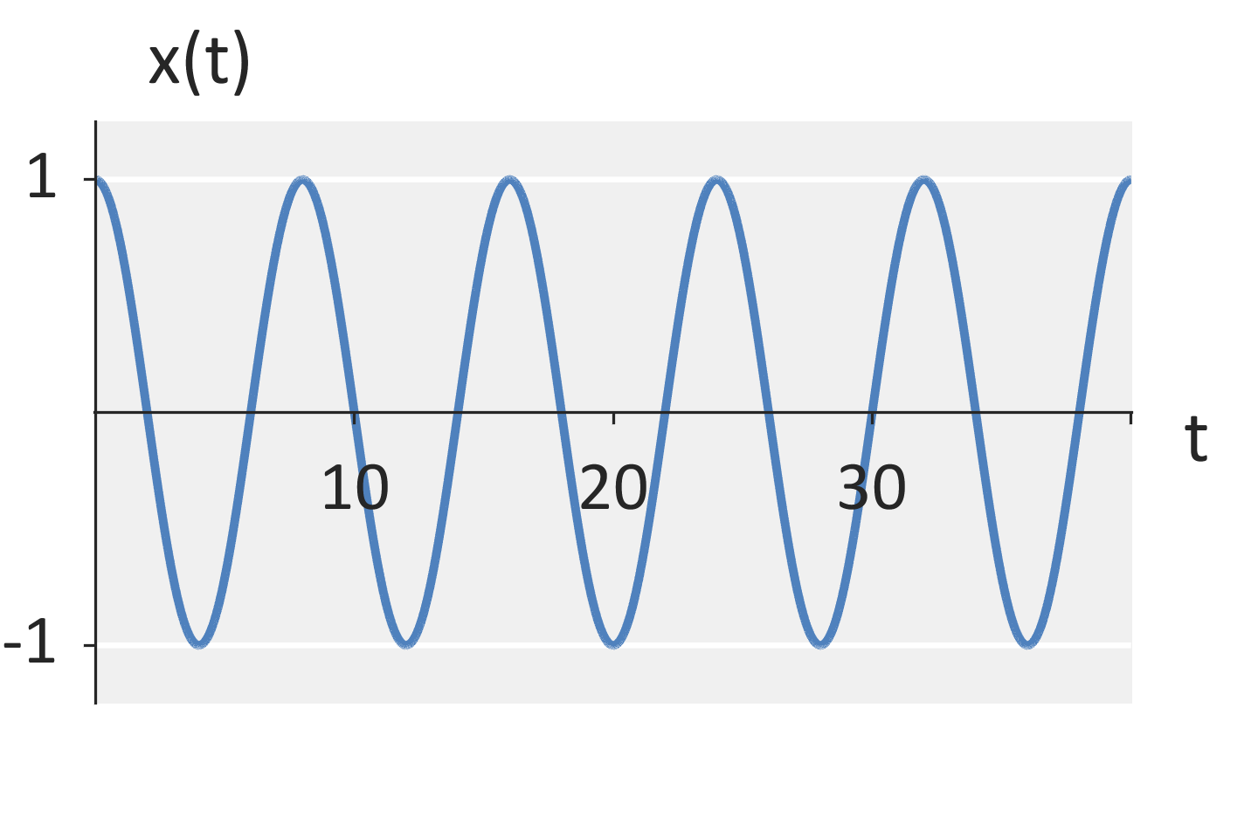
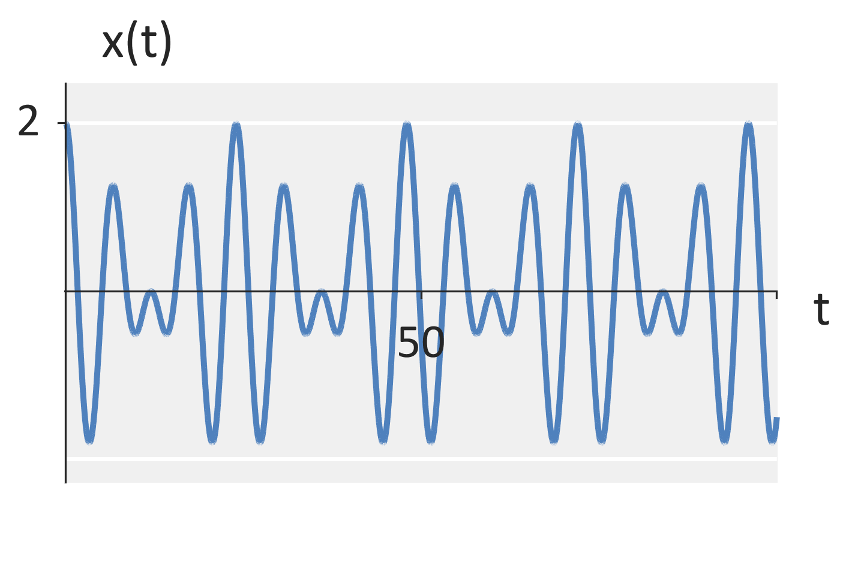
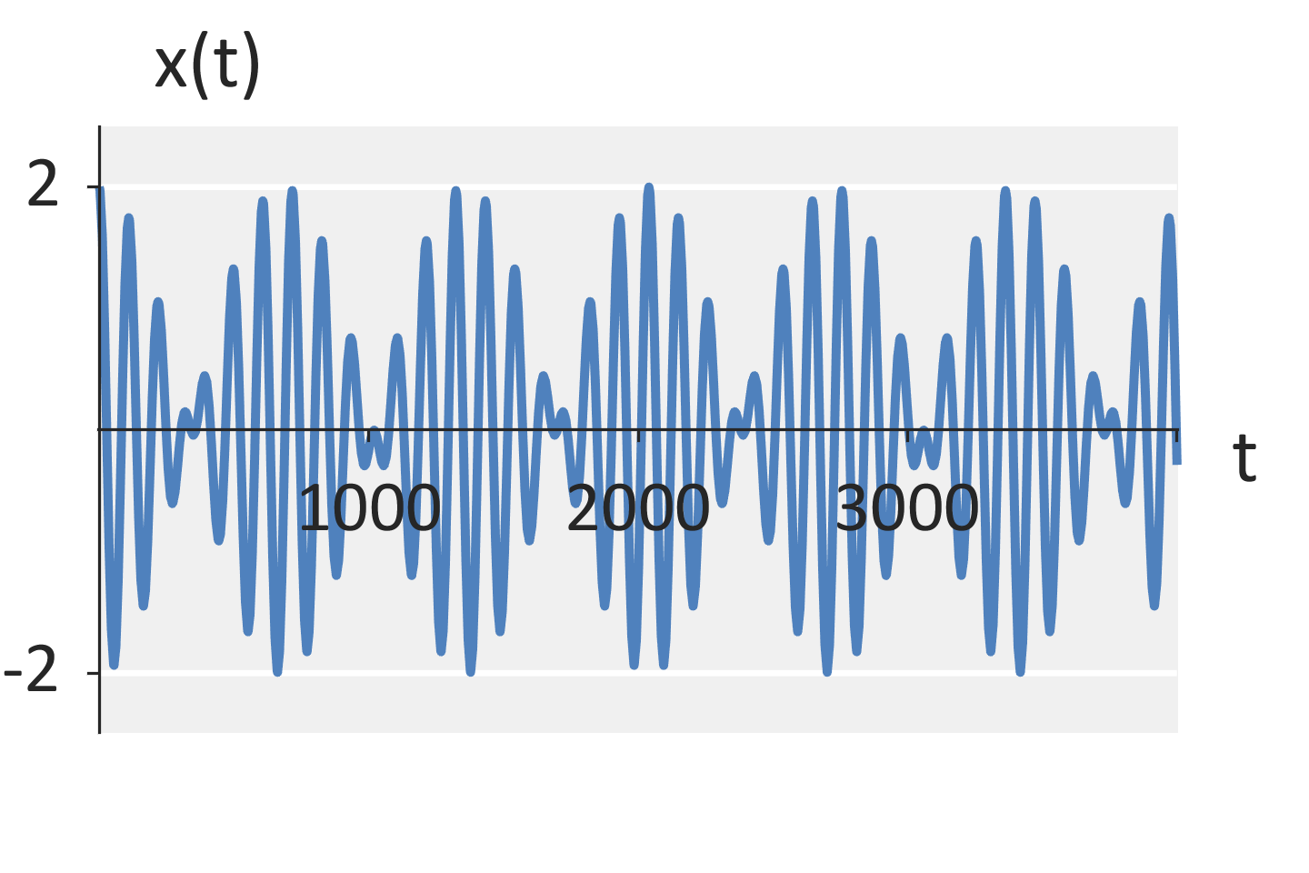
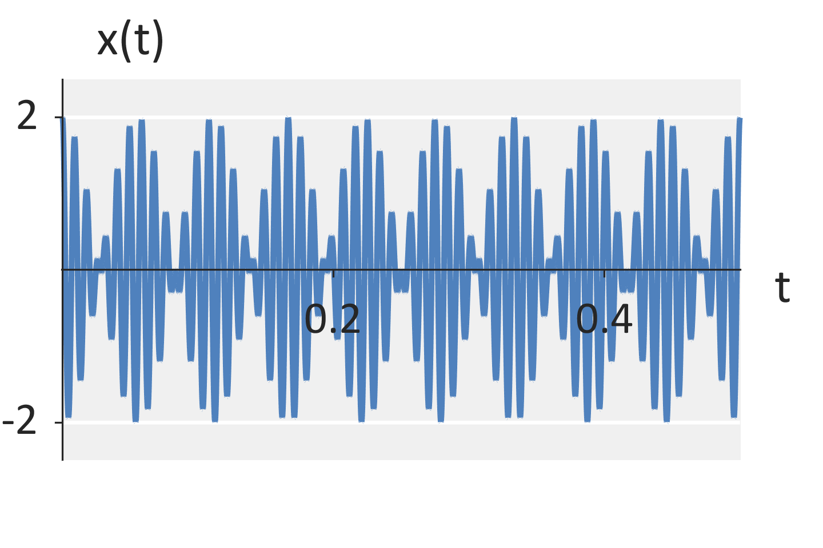
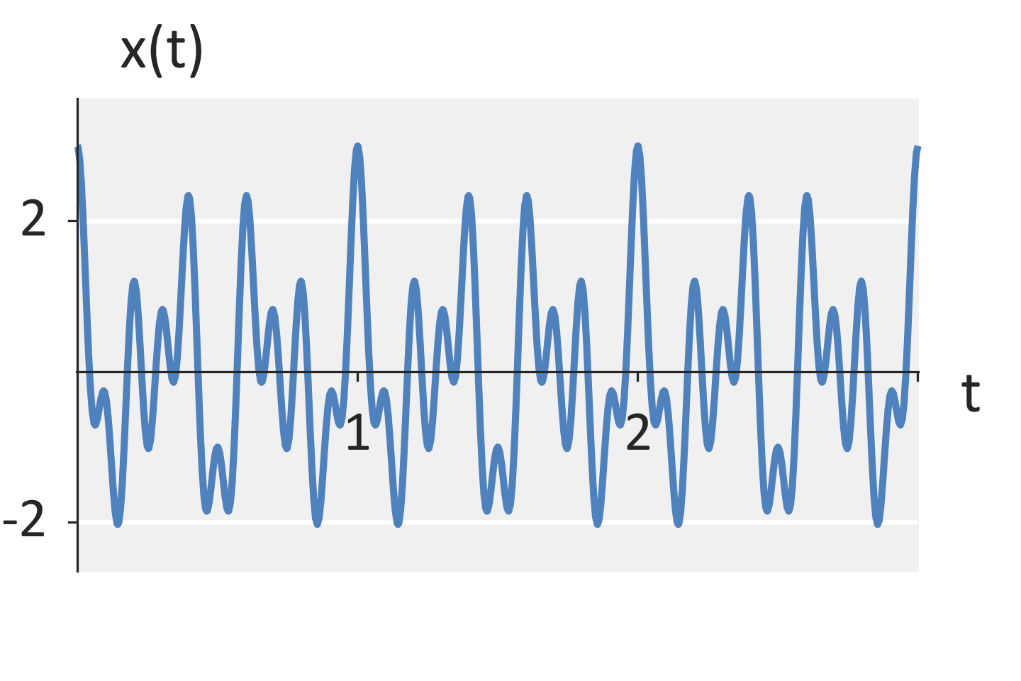
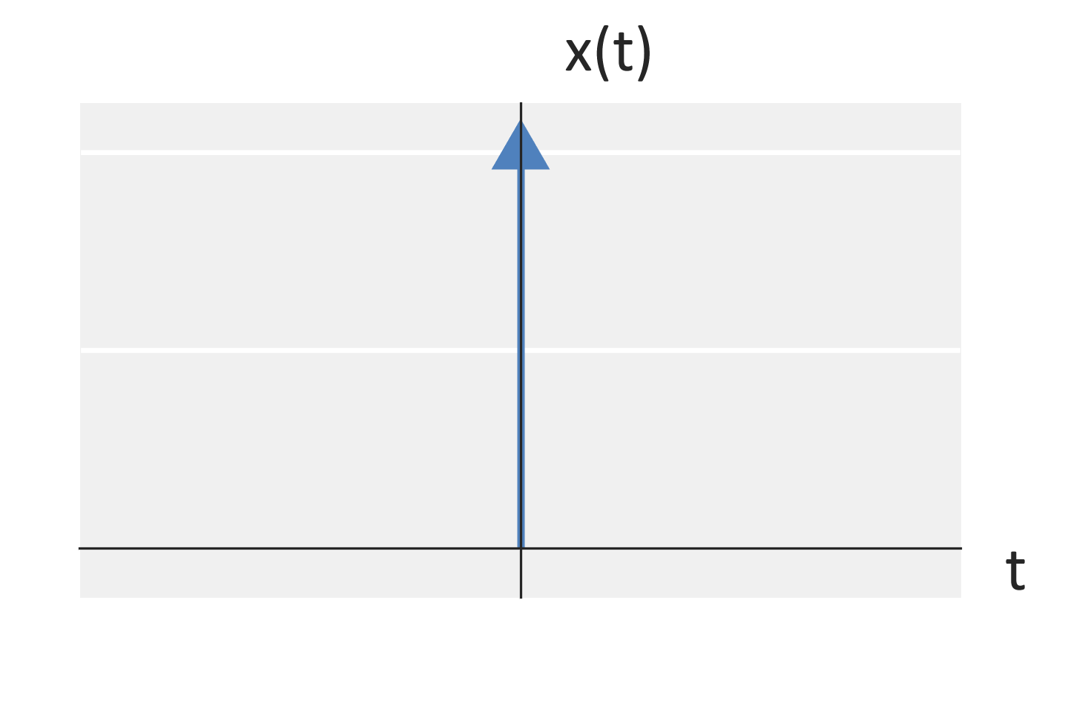
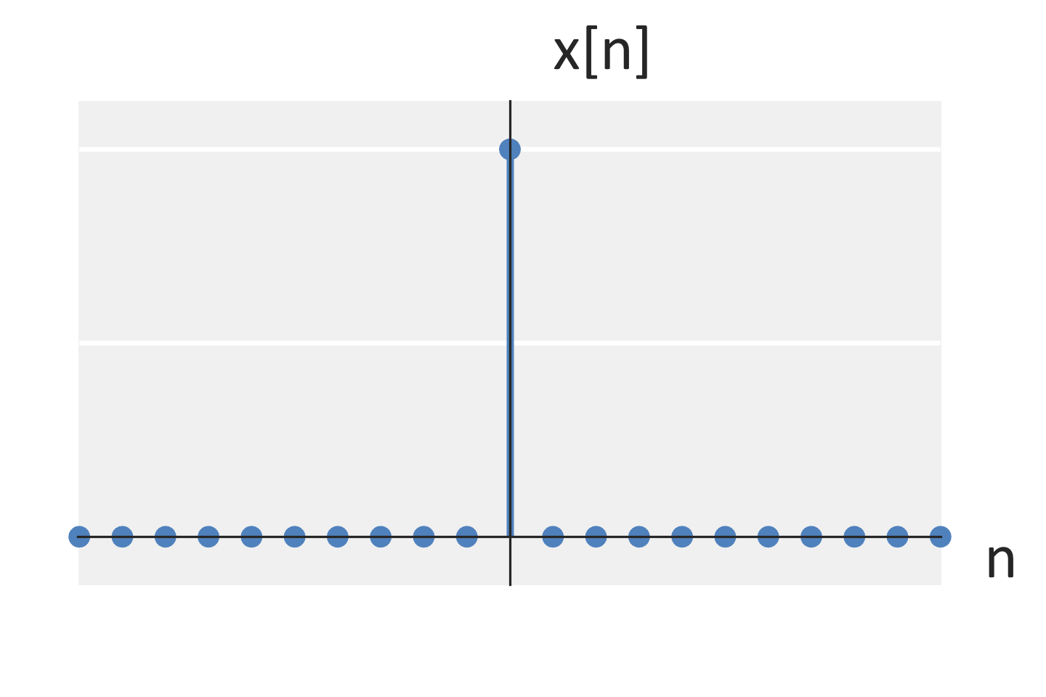
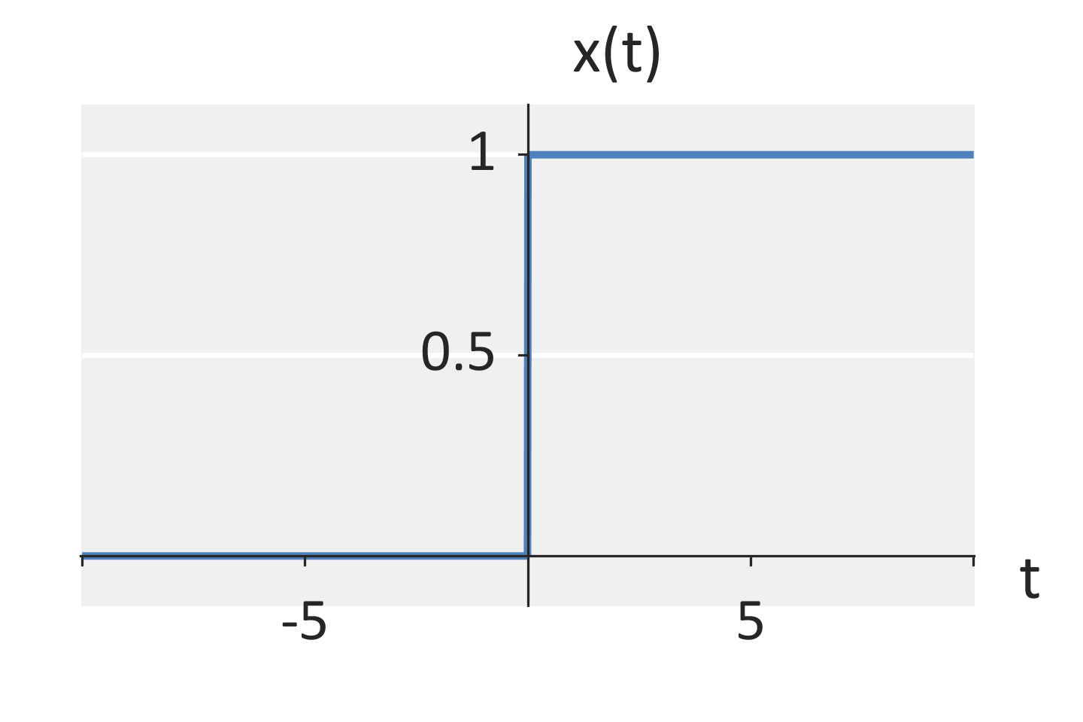
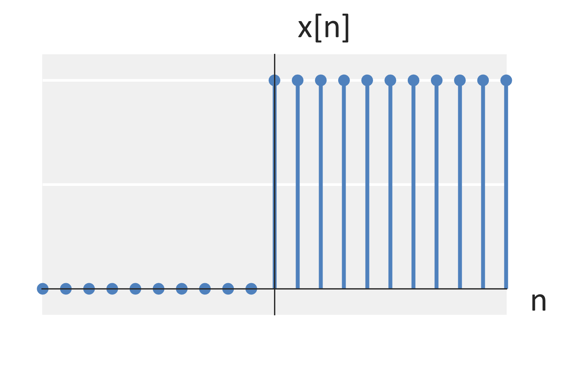
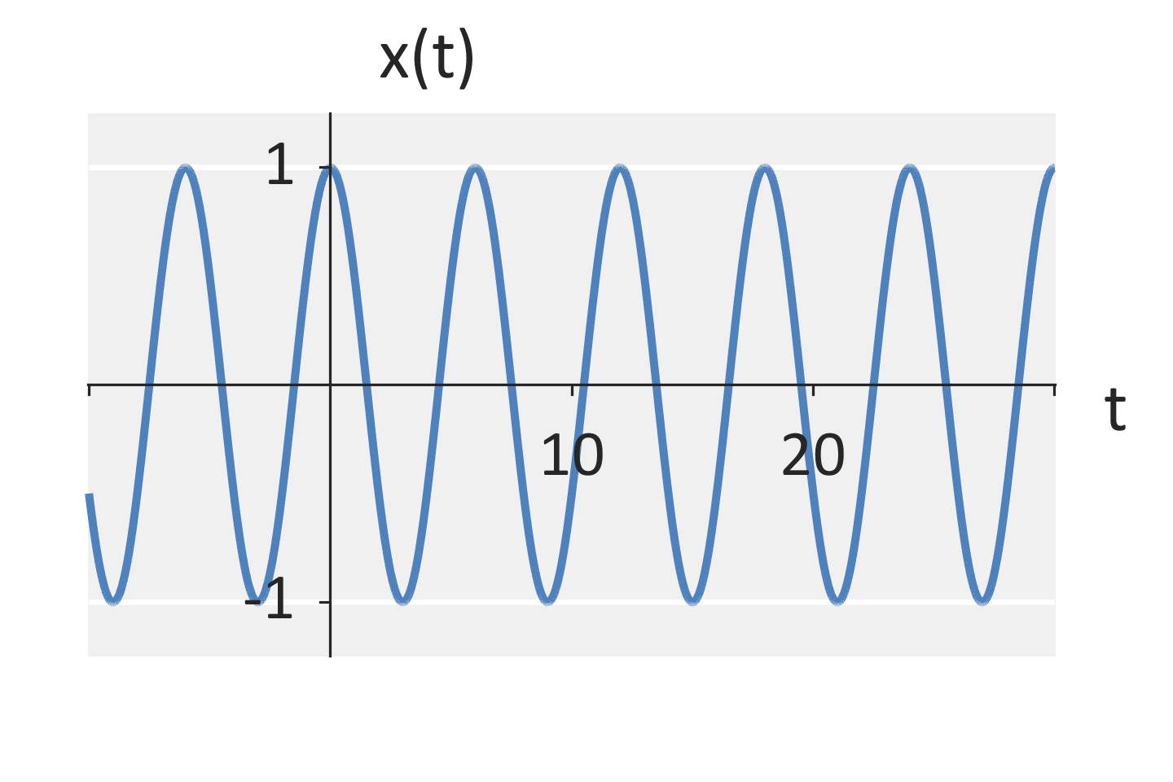
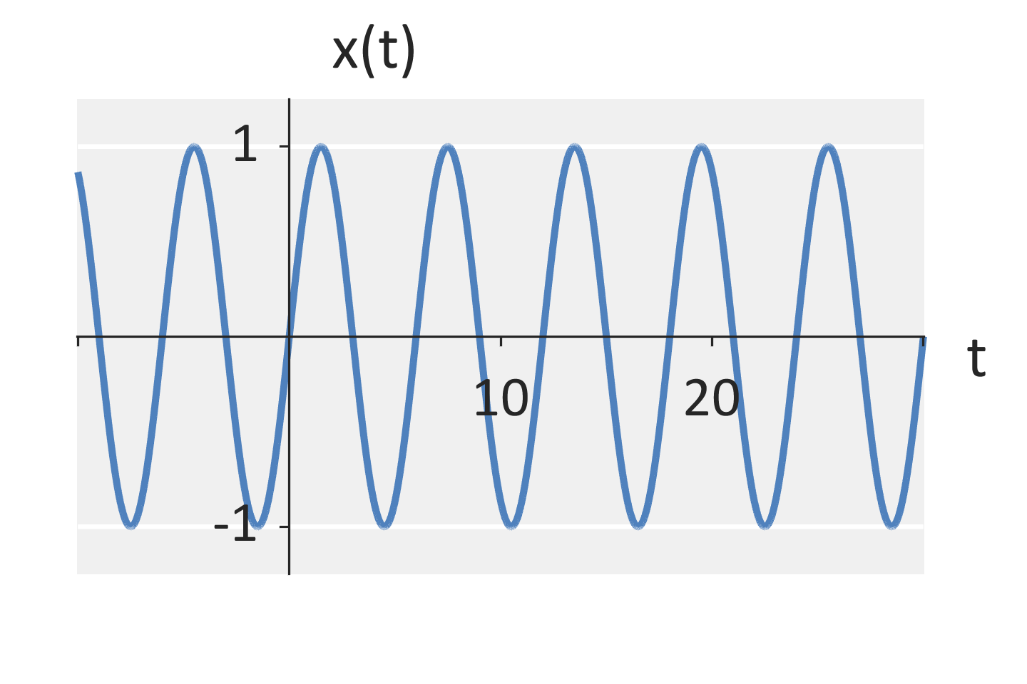

Systems
Input-output system model
  A generic system is defined by
  $$y\left[n\right]=H\left\{x\left[n\right]\right\}$$
Output
System
Input

Slide 4



Systems
A system is a mapping from inputs to and output
Input
System
Output
$$H\left\{⋅\right\}$$
$$x[n]$$
$$y[n]=H\left\{x\left[n\right]\right\}$$

Slide 5

Systems
Example systems
  $y\left(t\right)=2x\left(t\right)$
  $y\left(t\right)={\left|x\left(t\right)\right|}^{2}$
  $y\left(t\right)=\int_{−∞}^{t}{{\left|x\left(τ\right)\right|}^{2}}dτ$
  $y\left(t\right)=1$
  $y\left(t\right)+RC\frac{dy\left(t\right)}{dt}=x\left(t\right)$

Slide 6








Systems
Interconnections
  Serial
  Parallel
$$H_{1}\left\{⋅\right\}$$
$$H_{2}\left\{⋅\right\}$$
$$x[n]$$
$$y\left[n\right]=H_{2}\left\{H_{1}\left\{x[n]\right\}\right\}$$
$$H_{1}\left\{⋅\right\}$$
$$x[n]$$
$$y\left[n\right]=H_{1}\left\{x\left[n\right]\right\}+H_{2}\left\{x\left[n\right]\right\}$$
$$H_{2}\left\{⋅\right\}$$

Slide 7




Systems
Interconnections
  Feedback
$$H_{1}\left\{⋅\right\}$$
$$x[n]$$
$y\left[n\right]$ $=H_{1}\left\{x\left[n\right]\right\}+H_{2}\left\{y\left[n\right]\right\}$
$$H_{2}\left\{⋅\right\}$$

Slide 8
System Properties (General Systems)
Linear / Non-linear
Time-invariant / Time-varying
Memoryless / With memory
Causal / Anti-causal
BIBO Stable

Slide 9
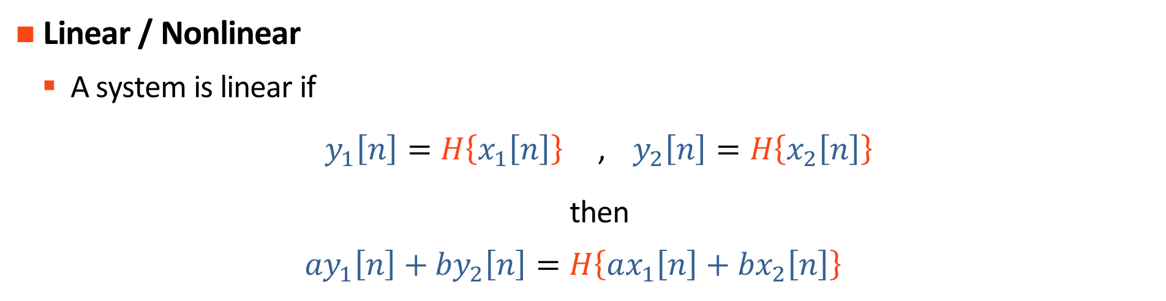
System Properties
Linear / Nonlinear
  A system is linear if
  $y_{1}\left[n\right]=H\left\{x_{1}\left[n\right]\right\}$ , $y_{2}\left[n\right]=H\left\{x_{2}\left[n\right]\right\}$
  then
  $$ay_{1}\left[n\right]+by_{2}\left[n\right]=H\left\{ax_{1}\left[n\right]+bx_{2}\left[n\right]\right\}$$

Slide 10













System Properties
Linear / Nonlinear
  A system is linear if
$$a$$
$$x_{1}\left[n\right]$$
$$H\left\{⋅\right\}$$
+
+
$$aH\left\{x_{1}\left[n\right]\right\}+bH\left\{x_{2}\left[n\right]\right\}$$
$$x_{2}\left[n\right]$$
$$H\left\{⋅\right\}$$
+
=
$$b$$
$$a$$
$$x_{1}\left[n\right]$$
+
+
$$H\left\{⋅\right\}$$
$$H\left\{ax_{1}\left[n\right]+bx_{2}\left[n\right]\right\}$$
$$x_{2}\left[n\right]$$
+
$$b$$

Slide 11

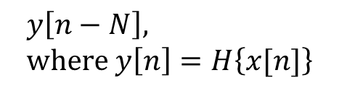





System Properties
Time-invariant / Time-varying
  A system is time-invariant if
  $$y\left[n\right]=H\left\{x\left[n\right]\right\}$$
  then
  $$y\left[n−N\right]=H\left\{x\left[n−N\right]\right\}$$
$$x\left[n\right]$$
Delay by N
$$H\left\{⋅\right\}$$
$$H\left\{x[n−N]\right\}$$
=
$$H\left\{⋅\right\}$$
Delay by N
$$y\left[n−N\right], \\ where y\left[n\right]=H\left\{x[n]\right\}$$
$$x\left[n\right]$$

Slide 12

System Properties
Memoryless / With memory
  A system $H\left\{⋅\right\}$ is memoryless if
    $y\left[n\right]$ is a function of $x\left[n\right]$ at only time n
    $y\left[n\right]$ is not a function of $x\left[n−N\right]$ for any $N>0$ (past values)
    $y\left[n\right]$ is not a function of $x\left[n+N\right]$ for any $N>0$ (future values)
$$H\left\{⋅\right\}$$
Delay by N
$$y\left[n−N\right], \\ where y\left[n\right]=H\left\{x[n]\right\}$$
$$x\left[n\right]$$

Slide 13
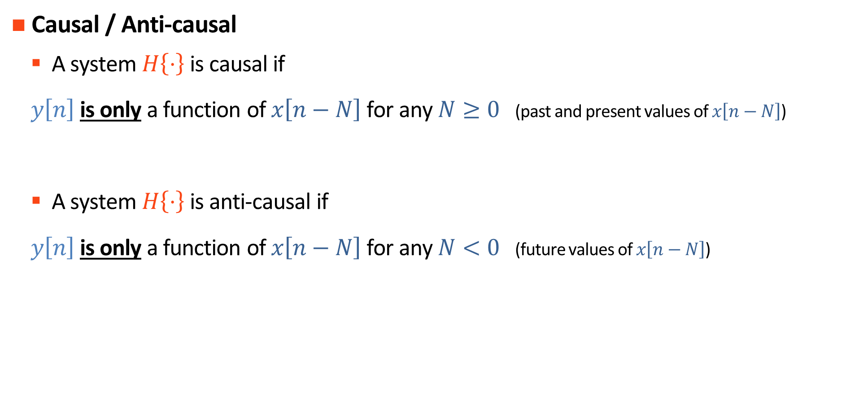
System Properties
Causal / Anti-causal
  A system $H\left\{⋅\right\}$ is causal if
  $y\left[n\right]$ is only a function of $x\left[n−N\right]$ for any $N≥0$ (past and present values of $x\left[n−N\right]$)
  A system $H\left\{⋅\right\}$ is anti-causal if
  $y\left[n\right]$ is only a function of $x\left[n−N\right]$ for any $N<0$ (future values of $x\left[n−N\right]$)

Slide 14

System Properties
Bounded-input, bounded-output (BIBO) stable / unstable
  A system $H\left\{⋅\right\}$ is BIBO stable if
  $$x\left[n\right]<∞$$
  implies
  $$H\left\{x\left[n\right]\right\}<∞$$

Slide 15
System Properties (LTI Systems)
Memoryless / With memory
Causal / Anti-causal / Acausal
BIBO Stable

Slide 16





Systems
Impulse Response
  Assume a (1) linear and (2) time-invariant system
    That system is uniquely characterized by its impulse response:
$$H\left\{⋅\right\}$$
$$δ\left(t\right)$$
$$y\left(t\right)=h\left(t\right)$$
$$x[n]$$
$$y[n]=h\left[n\right]$$

Slide 17

System Properties
Memoryless / With memory
  A linear, time invariant system $h\left[n\right]$ has memory if
  $h\left[n\right]=0$ for all $n$ except $n=0$
  or equivalently
  $$h\left[n\right]=A δ\left[n\right] for some A$$

Slide 18

System Properties
Causal / Anti-causal
  A linear, time invariant system $h\left[n\right]$ is causal if
  $h\left[n\right]=0$ for all $n<0$
  or equivalently
  $h\left[n\right]=g\left[n\right]u\left[n\right]$ for some $g\left[n\right]$

Slide 19

System Properties
Causal / Anti-causal
  A linear, time invariant system $h\left[n\right]$ is anti-causal if
  $h\left[n\right]=0$ for all $n≥0$
  or equivalently
  $h\left[n\right]=g\left[n\right]u\left[−n−1\right]$ for some $g\left[n\right]$

Slide 20

System Properties
Bounded-input, bounded-output (BIBO) stable / unstable
  A linear, time-invariant system $h\left[n\right]$ is BIBO stable if
  $$\sum_{n=−∞}^{∞}{{\left|h\left[n\right]\right|}^{2}}<∞$$

Slide 21
Example Problems

Slide 22

System Properties
Consider
  $y\left[n\right]=H\left\{x\left[n\right]\right\}=5x\left[n\right]+1$
  Is this system linear?
  Is this system time-invariant?
  Is this system memoryless?
  Is this system causal?

Slide 23

System Properties
Consider
  $y\left[n\right]=H\left\{x\left[n\right]\right\}=5x\left[n\right]+1$
  Is this system linear?
    $H\left\{ax_{1}\left[n\right]+bx_{2}\left[n\right]\right\}=5\left(ax_{1}\left[n\right]+bx_{2}\left[n\right]\right)+1$
    $H\left\{ax_{1}\left[n\right]\right\}+H\left\{bx_{2}\left[n\right]\right\}=\left[5\left(ax_{1}\left[n\right]\right)+1\right]+\left[5\left(ax_{2}\left[n\right]\right)+1\right]$
    Non-linear (non-equal)
  Is this system time-invariant?
  Is this system memoryless?
  Is this system causal?

Slide 24

System Properties
Consider
  $y\left[n\right]=H\left\{x\left[n\right]\right\}=5x\left[n\right]+1$
  Is this system linear?
  Is this system time-invariant?
    $H\left\{x\left[n+N\right]\right\}=5\left(x\left[n+N\right]\right)+1$
    $y\left[n\right]=5\left(ax\left[n+N\right]\right)+1$
    Time-invariant (Equal!)
  Is this system memoryless?
  Is this system causal?

Slide 25

System Properties
Consider
  $y\left[n\right]=H\left\{x\left[n\right]\right\}=5x\left[n\right]+1$
  Is this system linear?
  Is this system time-invariant?
  Is this system memoryless?
    $y\left[n\right]$ only depends on $x\left[n\right]$ at the current time
    Memoryless
  Is this system causal?

Slide 26

System Properties
Consider
  $y\left[n\right]=H\left\{x\left[n\right]\right\}=5x\left[n\right]+1$
  Is this system linear?
  Is this system time-invariant?
  Is this system memoryless?
  Is this system causal?
    Causal because we are memoryless

